Slide 1

Data Science Project Report On Cardiovascular Diseases (Heart Disease) for Zidio Tech
By Atumonye James Chukwuemeka

Slide 2
Contents
1. Introduction
2. The Goal of Analysis
3. General View of Data
4. Exploring the Data
5. Importation of Libraries
7. Results
8. Conclusion

Slide 3
1. Introduction
Cardiovascular disease(CVD) is the most seen death cause in all over the world today. Many researches have been done in this area and many of them are ongoing. Like many others, now the researches are more focused around the data analysis, machine learning models. The questions are, what causes the heart disease and how can we prevent it? In our dataset, we have a small size observation to fit the outputs to a predictive model but we have made a simple exploratory data analysis to obtain a bit more comprehensive look. We have sought an answer to which variables have more effect on heart disease diagnosis.

Slide 4
2. Goal of the Project:
The main aim of this project is to build a model that can predict and Detect whether a patient has a Cardiovascular disease of not. This will help in the early detection of the disease and help in preventing circumstances that can arrive due to complacency.
The first second which we try to achieve in this project is to get more clarified sight for which kind of attributes may be a more significant signal of incoming heart disease. We are not going to go into the deepest point but we will get a better understanding of the data without a doubt.

Slide 5
3. General View of Data
Variables:
age: The person’s age in years
sex: The person’s sex (1 = male, 0 = female)
cp: The chest pain experienced (Value 1: typical angina, Value 2: atypical angina, Value 3: non-anginal pain, Value 4: asymptomatic)
trestbps: The person’s resting blood pressure (mm Hg on admission to the hospital)
chol: The person’s cholesterol measurement in mg/dl
fbs: The person’s fasting blood sugar (> 120 mg/dl, 1 = true; 0 = false)
restecg: Resting electrocardiographic measurement (0 = normal, 1 = having ST-T wave abnormality, 2 = showing probable or definite left ventricular hypertrophy by Estes’ criteria)
thalach: The person’s maximum heart rate achieved
exang: Exercise-induced angina (1 = yes; 0 = no)
oldpeak: ST depression induced by exercise relative to rest (‘ST’ relates to positions on the ECG plot. See more here)
slope: the slope of the peak exercise ST segment (Value 1: upsloping, Value 2: flat, Value 3: downsloping)
ca: The number of major vessels (0–3)
thal: A blood disorder called thalassemia (3 = normal; 6 = fixed defect; 7 = reversible defect)
target: Heart disease (0 = no, 1 = yes)
Above we see which variables are numerical and continuous and which variables are categorical. In the raw dataset, data has 76 attributes but all published experiments refer to using only 14 of them. The version which we get also has 14 attributes.

Slide 6
4. Exploring the Data
Categorical variables:
sex
fasting blood sugar(fbs)
resting electrocardiographic results(restecg)
exercised induced angina(exang)
Thal ( thallium stress result)
target
chest pain distribution(cp)
Continuous variables:
age
cholesterol serum(chol)
maximum heart rate achieved(thalach)
Oldpeak(ST depression )
Slope( slope of peak ST segment )
number of major vessels(ca)
Trestbps( resting blood pressure )

Slide 7
Importation of Libraries:
import numpy as np
import pandas as pd
import matplotlib.pyplot as plt
import seaborn as sns
import warnings
from sklearn.model_selection import KFold, StratifiedKFold, cross_val_score
from sklearn import linear_model, tree, ensemble

Slide 8
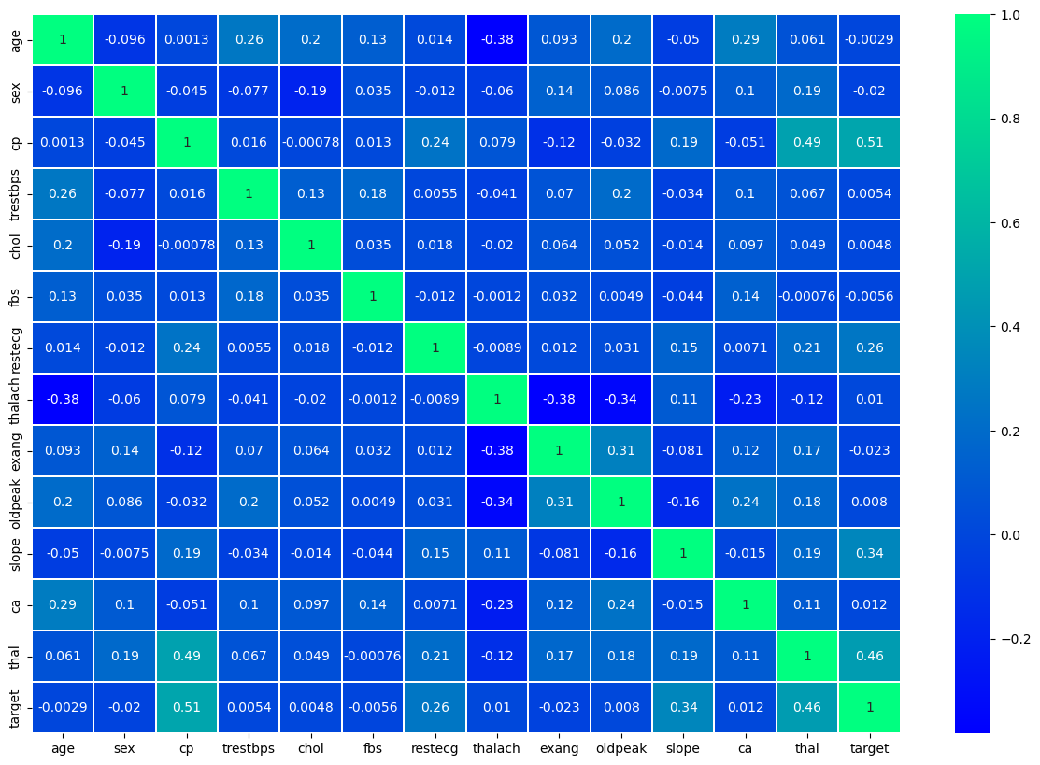
Visulaizing the data features to find the correlation between them.

Slide 9
Results:
After modeling the dataset, the dataset was divided into X =(All columns exercpt “Target” column.) y =( Target column).
From Sklearn, Test_test_split was imported. (sklearn.model_selection import train_test_split)

Slide 10
X_train, X_test,y_train, y_test=train_test_split(X,y,test_size=0.3,random_state=42)
test_size=0.3: This parameter specifies the proportion of the dataset that should be included in the testing set. In this case, 30% of the was used for testing, and the remaining 70% will be used for training.
random_state=42: This parameter sets the seed for the random number generator, ensuring that the data is split in the same way every time the code is run. This helps in obtaining reproducible results.
By splitting our data into training and testing sets, we can train our machine learning models on one subset of the data and evaluate their performance on another subset that the models haven't seen before. This helps in assessing how well our models generalize to unseen data.

Slide 11
Algorithm implememtation
from sklearn.linear_model import LinearRegression
reg = LinearRegression()
reg.fit(X_train, y_train)
print(forest_reg.score(X_test,y_test))
0.4372174893864803

Slide 12
from sklearn.tree import DecisionTreeRegressor
DTR = DecisionTreeRegressor()
DTR.fit(X_train,y_train).
print (DTR.score(X_train, y_train))
0.9134978450741829

Slide 13
from sklearn.tree import DecisionTreeClassifier
DTF = DecisionTreeClassifier()
DTF.fit(X_train, y_train)
Print (DTF.score(X_train, y_train))
print (DTF.score(X_train, y_train))
0.9567901234567902

Slide 14
from sklearn.ensemble import RandomForestClassifier
RFC = RandomForestClassifier()
RFC.fit(X_train, y_train)
print (RFC.score(X_train, y_train))
0.9567901234567902

Slide 15
After the testing and training of algorithms, RFC was deployed and was feed with data sets and it was able to Predict and Detect Patients with Cardiovascular disease.

Slide 16
Conclusion:
In conclusion, the successful completion and deployment of the Cardiovascular Disease (CVD) prediction and detection project mark a significant milestone in the realm of healthcare technology. Leveraging Random Forest Classifier (RFC) as the model of choice due to its superior accuracy, the project has demonstrated its efficacy in identifying and predicting patients at risk of CVD. By feeding real-world data into the deployed model, it has exhibited its ability to provide timely and accurate diagnoses, potentially saving lives through early intervention and preventive measures. This project underscores the potential of machine learning in revolutionizing healthcare by enabling proactive and personalized approaches to disease management. Moving forward, continued refinement and integration of such models into clinical practice hold promise for improving patient outcomes and reducing the burden of cardiovascular diseases on individuals and healthcare systems alike.

